Slide 1

Operating Systems OS2 Week 1-2
Joris Geurts

Slide 2

Your teacher
Andre Postma
e-mail: a.postma@fontys.nl
Office: R10 4.45

Slide 3
OS2 week planning
thread pool, cyclic barrier, countdown latch
readers-writers
reentrant lock, condition
sockets
deadlock
banker's algorithm
recap

Slide 4
Organization
Same as OS1:
7 weeks:
1 block of 4 hours; each time
Theory
Class assignments
If time permits, work on weekly assignments
Homework:
work on weekly assignments
Theory exam in week 8 (or 9)
Will be a laptop exam, everything stored locally on your laptop is allowed
no books, no papers allowed
Intranet:
slides + lab manual + class assignments + links to prerecorded videos
Canvas:
Handing in assignments/attendance

Slide 5
Practical
Weekly assignments, made in couples
Delivery in Canvas (ask for invitation to join the course)
Practical is highly recommended but not mandatory
Delivered assignments will be checked for completeness
If you want to discuss your assignment with teacher, ask for it
Otherwise, discussion will be done at random as far as time permits
E-S41: Practicum groups 1-20
E-S42: Practicum groups 21-40
E-S43: Practicum groups 41-60

Slide 6
Extra OS2 exams next semester
OS2 is phased out.
If you do not pass the OS2 exam in week 8 or 9, there are two last chances next semester to pass the OS2 exam.
Written exams next semester
No auxiliary items allowed (no laptop, no books, no notes)
After next semester there is no more OS2 exam!
If you do not pass OS2 in this or the next semester, you will have to do new curriculum S3.

Slide 7
Content of the exam
All course material for OS2, including:
Theory (found on the slides and in the reader)
All practical assignments (lab manual and extra assignments)
All class assignments
All demos
All videos
Old exams
All course materials can be found on the sharepoint.

Slide 8
Overview
Repetition OS1
Package java.util.concurrent
Thread Pools
CyclicBarrier
CountdownLatch
Notes:
Next: what is an OS

Slide 9
Recap OS1 (I)
Linux
Java FX GUI
synchronized
events
Shared
objects
wait/notify
JAT
threads
Platform.runLater()

Slide 10
Some remarks
Some items not discussed
Java byte code
JAR files
Interrupting threads, handling the interrupts
Scheduling algorithms

Slide 11
Recap OS1 (II)
Shared data: data that is used in several threads
Critical Section: code that is involved in reading and writing shared data
Mutual exclusion: only one thread is executing a Critical Section
In Java:
synchronized
Now practice with class assignment, part 1.

Slide 12
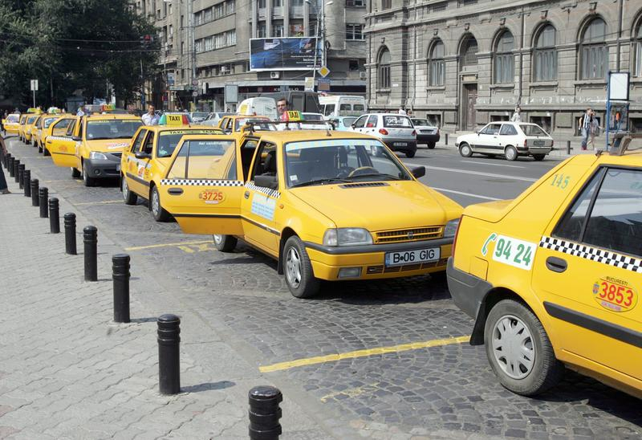
Thread Pool
Contains number of threads; executing/waiting for tasks
We can give tasks to thread pool:
task executed by one of the threads
if all threads busy, task has to wait
thread stays alive when task finished
non-active threads are blocked (take no CPU-time)
Advantages:
Re-using old thread is faster than creating new thread
Number of threads is limited to size of pool
Notes:
Dsiadvantages:
1. Task may have to wait longer if all threads busy.
2. (for fixed threadpool): threads are not guaranteed to start
(e.g. fixed threadpool of 4 and four producer threads and one consumer thread)
When 4 producer threads are scheduled, the consumer thread will not get the CPU

Slide 13
Some remarks
Idea of the threadpool is to save overhead by creating threads only once and re-use them for multiple tasks
Creating and starting a thread takes time
Runnable r = new MyRunnable();
Thread t = new Thread(r);
t.start();
Threadpool is more efficient only if threads are re-used!
Cf.
Use brand new taxi for every ride or
Re-use same taxi for multiple passengers
Takes time

Slide 14
Thread Pools in Java
Creating thread pool with 10 threads:
ExecutorService pool = Executors.newFixedThreadPool(10);
Giving a task to the thread pool:
pool.execute(task);
task must be a Runnable
task will be executed by one of the threads
unpredictable when task will actually start

Slide 15
Some remarks
It is unpredictable when a task in a threadpool will start
With a fixed threadpool it is not even guaranteed that a task will start at all
Examples:
Infinite tasks
Applications in which threads may have to wait:
Producer / consumer problem
Application that uses cyclic barrier or countdown latch
For these applications there is a risk of deadlock!
With a cached threadpool, no risk on deadlock because of the waiting threads.

Slide 16
Closing a Thread Pool
We must be able to shut down a thread pool in a controlled way
We can do this with method shutdown()
pool.shutdown();
no new tasks can be submitted anymore
when all tasks are finished, thread pool is deleted

Slide 17
Interrupting threads in a threadpool
Note that pool.shutdown() does not interrupt running threads in a threadpool, they just run to completion
If you want to interrupt them, you can use pool.shutdownNow().
The effect of shutdownNow() is the same as of shutdown():
no new tasks can be submitted anymore
when all tasks are finished, thread pool is deleted
but in addition:
an interrupt is sent to all running threads in the threadpool
the call prevents waiting tasks from starting
(Note that it is up to the programmer to handle the interrupt inside the thread)
To interrupt specific threads in a threadpool, see:
http://stackoverflow.com/questions/3777772/how-to-stop-a-thread-in-a-threadpool

Slide 18
Some remarks
Shutdown
Cf. roller coaster (De Baron) in the Efteling
Closing the queue 1 hour before the park is closed
Everyone in the queue may still enter the rollercoaster
ShutdownNow
Cf. Student administration at Fontys
Closes at 4 pm, regardless whether students are waiting or not
Waiting queue is removed, and students being served must finish as soon as possible
For fixed threadpool you must shutdown the pool
For cached threadpool, this is not necessary

Slide 19
5 Thread Pool architectures
Single thread executor - pool of size 1
ExecutorService pool = Executors.newSingleThreadExecutor();
Fixed thread executor - pool of fixed size
ExecutorService pool = Executors.newFixedThreadPool(size);
Cached thread pool - creates new threads when necessary; deletes unused threads after 60 sec
ExecutorService pool = Executors.newCachedThreadPool();
Scheduled thread pool – fixed size pool for scheduled or repeated execution (after certain delay)
ScheduledExecutorService pool = Executors.newScheduledThreadPool(size);
Single scheduled thread pool – pool of size 1 for scheduled or repeated execution
ScheduledExecutorService pool = Executors.newSingleThreadScheduledExecutor();
Notes:
19
Cached: idle threads are kept for 60 seconds
Fixed: threads above poolsize are put in a queue
Scheduled: replacement for java.util.Timer to execute tasks (especially for the single scheduled thread pool)
Note:
Use a cached threadpool only when you have a reasonable number of threads, or when they have a short duration.

Slide 20
Some remarks
Five different threadpool architectures
You need only remember fixed and cached threadpools
3 main differences between fixed and cached threadpool?

Slide 21
Some remarks
Cached threadpool:
Advantages:
we can still re-use threads
Threads will not stay forever in the threadpool
No risk on deadlock with waiting threads

Slide 22
Thread pools
Now practice with class assignment part 2

Slide 23
Synchronizers
Java offers a package with synchronization-mechanisms: java.util.concurrent
In this package we find:
Semaphore (not discussed here)
CountdownLatch
CyclicBarrier
…

Slide 24
CyclicBarrier
Let a number of threads wait for each other
CyclicBarrier cb = new CyclicBarrier(5);
Suppose we have 5 threads that do the following:
... // do a certain calculation cb.await(); ... // wrapping up
The first 4 threads will be blocked in cb.await()
As soon as the 5th arrives, all 5 continue

Slide 25
Some remarks
Cyclic barrier:
One method call: await()
Effect of the await() depends on the number of preceding awaits
Effect of every 5th await is like a notifyAll
Effect of other awaits is like a wait
Usage: on a synchronization point, all threads must wait
(so we have one group of threads)

Slide 26
CountDownLatch
Wait until 0 is reached
Is initialized to a certain value
Has a countDown() method that lowers the value
Has an await() method where threads are blocked
When the value becomes 0, all blocked threads are woken up

Slide 27
Some remarks
Countdown latch:
Two method calls: await() and countdown()
Usage:
On a synchronization point,
One group of threads must wait (using await)
Other threads can continue (using countDown)
Note: there can be multiple synchronization points. Consider the situation separately for each one of them!

Slide 28
Some remarks
Concurrent Animated jar
It is a PPT, you can use up and down arrows to navigate
Nervous arrows are misleading – actually the threads are blocked and consume no CPU time

Slide 29
Example CountDownLatch (1)
Suppose
you have a thread pool,
N tasks for that pool,
main thread must wait until all N tasks are finished

Slide 30
Some remarks
When using a countdown latch
cdl.await() can be done in the main thread,
but you should not do so when the main thread is the JAT
(then you block the JAT)

Slide 31
Example CountDownLatch (2)
class WorkerRunnable implements Runnable { CountDownLatch doneSignal; WorkerRunnable(CountDownLatch d) { doneSignal = d; } public void run() { doWork(); doneSignal.countDown(); } }
CountDownLatch doneSignal = new CountDownLatch(N); ExecutorService e = ... for (int i = 0; i < N; i++) e.execute(new WorkerRunnable(doneSignal)); try { doneSignal.await(); } catch (InterruptedException ex) {}
Notes:
Next: atomic variables (when you just need simple data sharing)

Slide 32
Synchronization primitives
Now practice with class assignment part 3

